Slide 1



PEGA
Use case presentation

Slide 2
Patient Registration and Onboarding
By
Uppala Vaibhav Kumar
Aakash Naram
Manchala Rishik

Slide 3
Agenda
Concepts Covered
Use Case Overview
Use case Flow
Stages and Processes
Data Models
Key Features and Configurations

Slide 4
Concepts Covered
Case Design(Primary & Alternate Stages)
Multi Step Form
Data Design
Data Transform
Data Propagation
Locally Sourced Data
Data pages
Document generation
Validations

Slide 5
Use Case Overview
Objective of this use case is to digitalize the Patient registration
,Medication and follow-up process using PEGA.
Patient can self register through the “Patient247” application, providing their personal details, medical history and insurance information.
Once the registration is complete, the system captures all necessary information. An onboarding document is generated, confirmation email is sent to patient for confirmation and completion of the onboarding formalities.

Slide 6
Use case Flow
Let’s see

Slide 7

Registration
Multi Step Form
Collect Personal Details
Collect Address
Collect Medical History
New Patient
Patient
Type
login
user
Existing
Login
Submission
Insurance Details
Collect Declaration
Collect Treatment Details
Collect test Reports
user
Review Details is Routed to Admin
If Approved
Admin
End
If Rejected
Review &
Approval
Review Details
Approval is Routed
to Doctor
Doctor

Slide 8
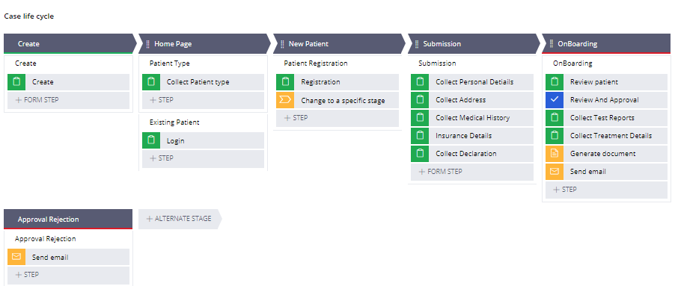
Stages and Processes
Patient Registration
Submission
Multi Step Form
New Patient
Existing Patient
Patient Type
Home Page
Onboarding
Onboarding

Slide 9
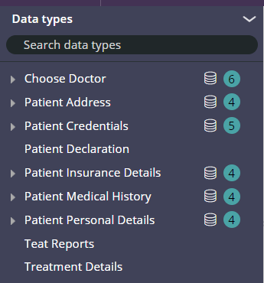
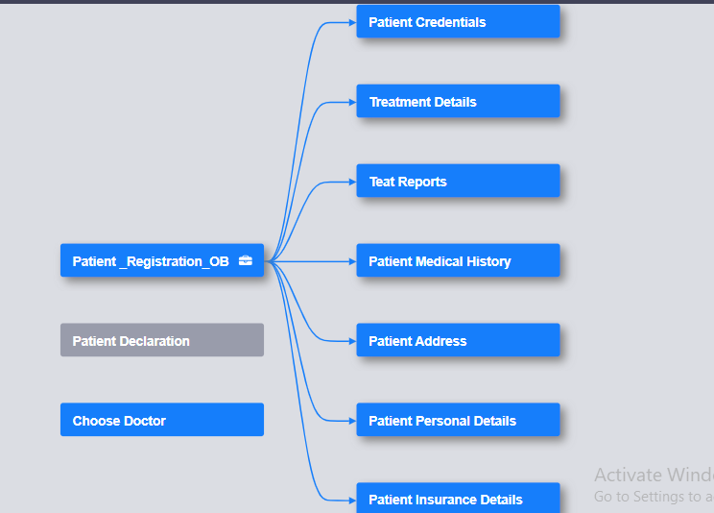
Data Types

Slide 10
Key Features and Configurations
Saving the Collected Details in to Data Records like Registration, Personal , Medical, Insurance Details.
Patient ID Random Generation,
Authenticating Patient,
Date of Birth Validation,
Auto Populate Insurance Details,
Cascading Dropdown in Choosing Doctor,
Treatment - No of days , From Date , To Date is Validated,
Generation of pdf document.

Slide 11
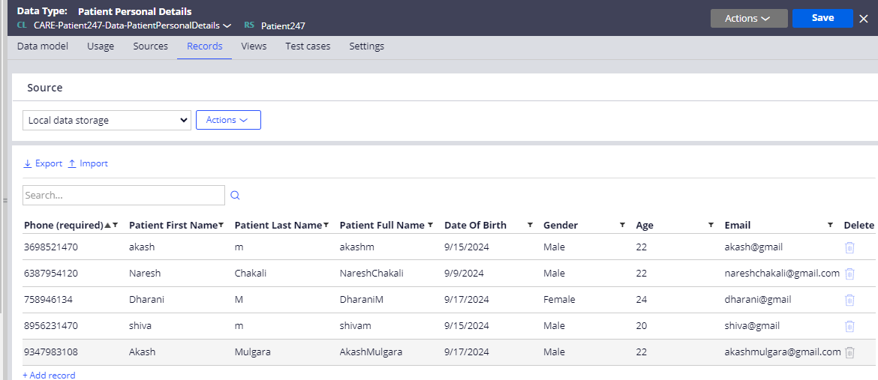
Saving the Records
Patient Credentials , Patient Personal Details , Patient Address , Patient Medical History , Insurance Details are saved in the Data Types for Future Reference.
Rules Used : Data Page , Data Transform,

Slide 12
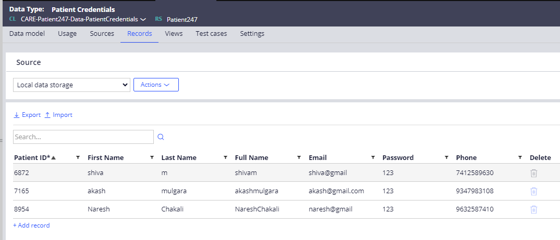
Patient ID Random Generation,
Generating a unique Random 4-digit Number for Every Registration,
By Using the Expression builder,
Expression : @round(@Random.random(1,9999))

Slide 13
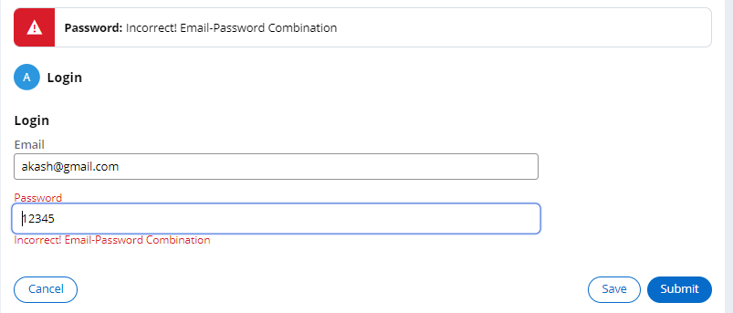
Authenticating Patient
Checking of Correct Email-Password Combination Entered by the user
Rules Involved : Data Page , Report Definition , Post Processing Validation,
Authenticating user based on the Clipboard’s “pxResultCount”.

Slide 14
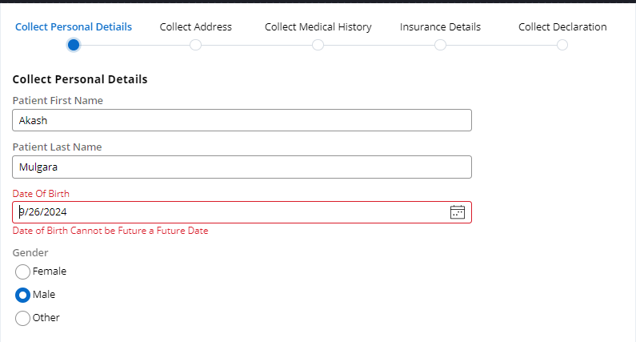
Date of Birth Validation
Date of Birth Selected by the user cannot be Future,
It is a Flow Action Validation.

Slide 15
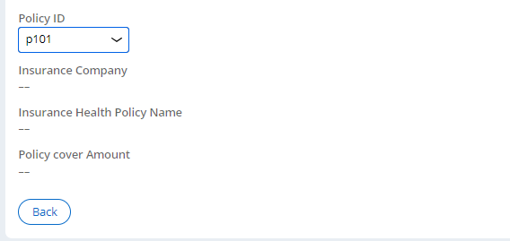

Auto Populate Insurance Details
Auto Populating the Insurance Company , Insurance Health Policy Name , Policy cover Amount.
When ever there is a change in the Policy ID Dropdown,Fields are auto populated,
Actions used are Run Data Transform and Refresh this Section,

Slide 16
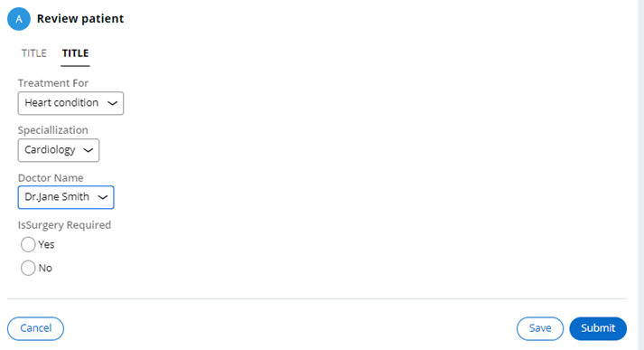
Cascading Dropdown
Selecting the Doctor Based on the Treatment and Specialization.
By Data Page and Report Definition Rules.

Slide 17
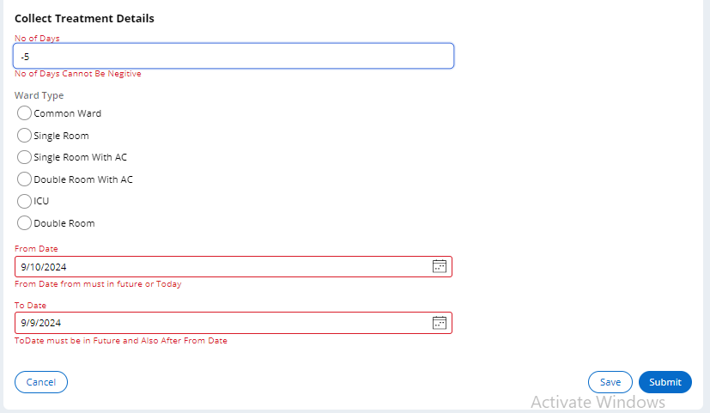
Treatment Details validations
No of days , From Date , To Date are Validated,
Post Processing Flow Action Validation.

Slide 18
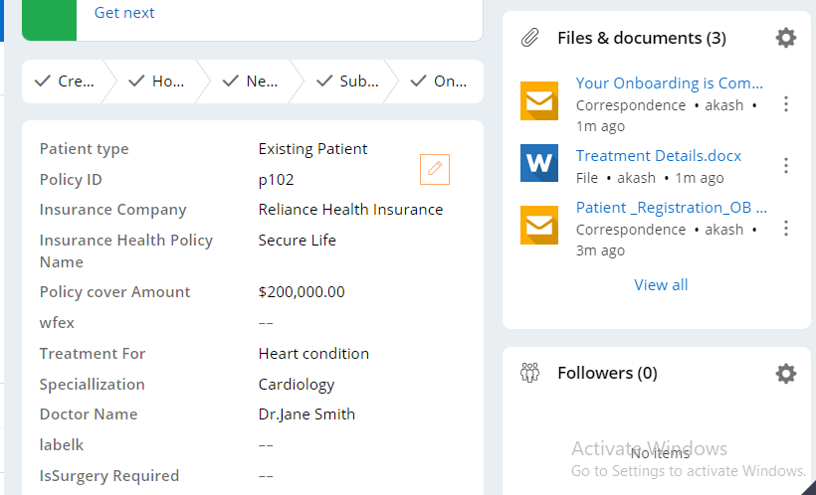
Generation of pdf document
Genaration of pdf , which contains all the Collected Details,
Based on the Template Document(Word Document)

Slide 19
Thank You!
Floor is open for questions

